Slide 1


Development and application of a web scoring management service in Drug Design
Pustoshilov Dmitriy Vasilievich.
MIPT, "Industrial Bioinformatics".
Supervisor: Anna Borisovna Malashicheva.
Ph.D. in Biology, Chief Researcher,
Head of lab. Head: Anna B. Malashicheva Ph.D., Chief Researcher, Laboratory of Regenerative Biomedicine, Institute of Cytology, Russian Academy of Sciences
Notes:
Глубокоуважаемый председатель гос аттет комиссии, глубоко члены, коллеги
Моя работа посвяще

Slide 2
Terminology
Disease
participate in the development of
Proteins (targets)
suppress/activate
Molecules (ligands)
linkage modeling (docking)
are a
product of
many properties and ligands - scoring
Genes

Slide 3
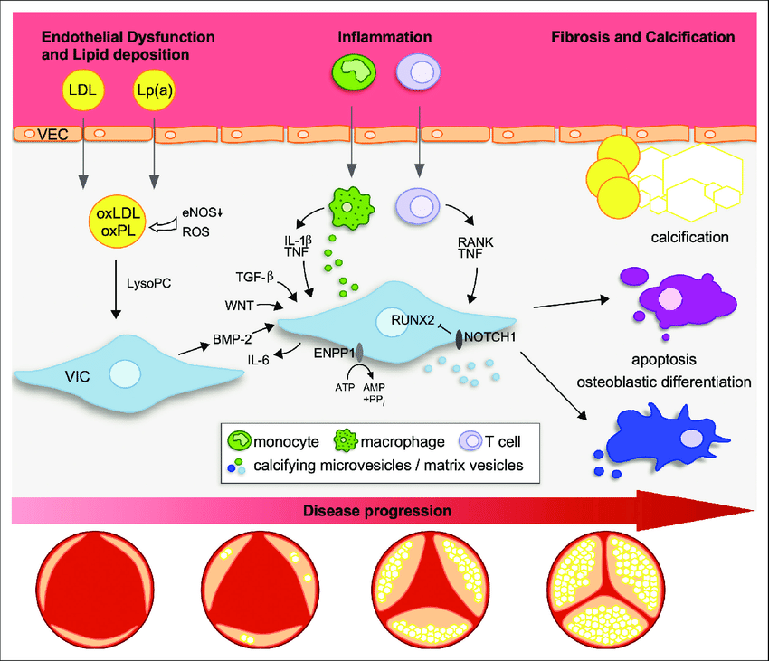
Problem: calcifying aortic stenosis
affects 1/100 of the population
surgical treatment
no therapy yet
verified molecules
Factors and stages of stenosis, doi.org/10.1093/eurheartj/ehab757
Notes:
болезнь кальцификации аортального клапана — заболевание сердца, характеризующееся прогрессирующим фиброзно-кальцинозным ремоделированием аортальных клапанов и дифференцировки клапанных интерстициальных клеток (VICs) в остеогенные клетки.
является ведущей причиной смертности от сердечно-сосудистых заболеваний и не поддается нехирургическому лечению. можем только облегчить

Slide 4
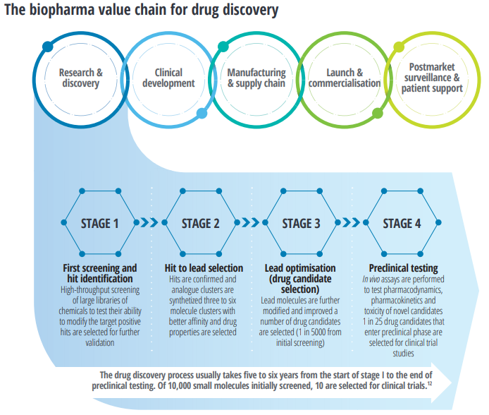
Problem: Drug design
Time frame: 10 years
Financing: $100 million
Risks of failure: 1/10 000
Professional software (doi.org/10.1001%2Fjamainternmed.2017.3601)
Repurposing lowers costs and risks
Stages of drug design quantori.atlassian.net/wiki/spaces/QK/pages/3030089792/Drug+design
Notes:
введение в драг дискавери

Slide 5
Object and purpose
The object of the study is the process of osteogenic differentiation of valve interstitial cells in calcifying aortic stenosis.
The purpose is to search for molecules that passed the fourth phase of clinical trials and potentially suppress osteogenic differentiation and select the most promising of them with the help of the developed Service.

Slide 6
Tasks
Literature review on the topics of calcifying aortic stenosis and drug design.
Collection of datasets of
verified molecules with experimentally confirmed inhibition of osteogenic differentiation
disease-associated proteins, genes, and their inhibitors.
Choice of drug repurposing approach.
Search of molecules by structural similarity.
Assessment of biochemical similarity of molecules.
Docking of assembled molecules and their targeting tags.
Multiparameter optimization (scoring)
Analysis of the best candidate.
Optional: development of a scoring service.

Slide 7
Literature analysis and dataset collection
134 ARTICLES «‎osteogenic differentiation valve interstitial cells», PubMed
27 MOLECULES experimentally verified suppression of osteogenic differentiation
201 GENES 176 PROTEINS involved in the development of the disease
314 MOLECULES of their inhibitory, DrugBank
+ missing information, PubChem, UniProt и DrugBank

Slide 8
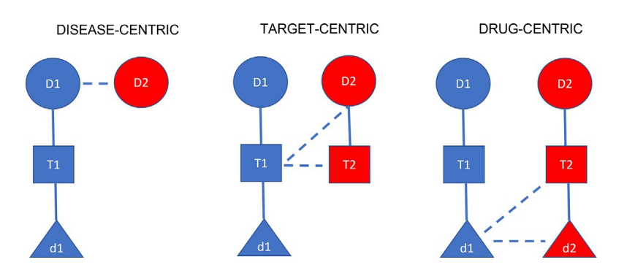
Choice of repurposing approach
no
additionally
main
Repurposing approaches, doi.org/10.1016/B978-0-12-820472-6.00108-0

Slide 9
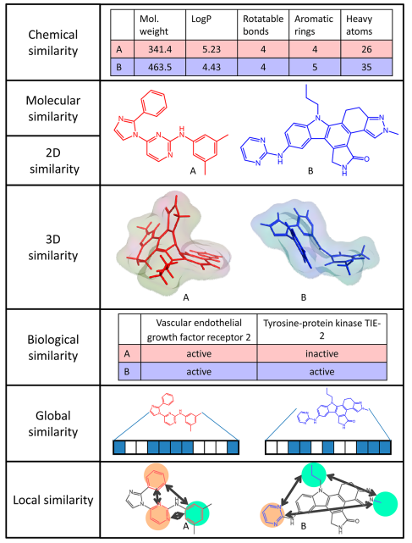
Choice of molecule comparison approach
Biochemical properties: in additionally
Structural properties: base
doi.org/10.1021/jm401411z
Notes:
понятия молекулярного сходства схожие соединения обладают сходными свойствами
фингерпринтинг – сравнение структур

Slide 10
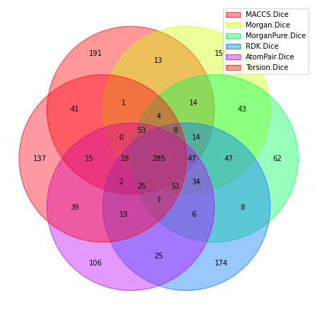
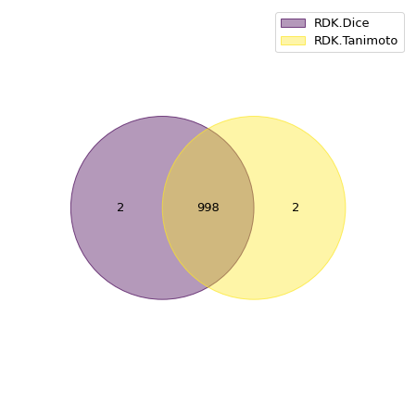
Search by structural similarity
For each of the 27 verified molecules, we collect similar ones from 13,000 molecules in DrugBank
Fingerprinting RDKit:
Torsion
AtomPair
RDK
Morgan+Features
Morgan
MACCS
Similarity Metrics:
Tanimoto
Dice
Result: dataset of 3,250 molecules
Venn diagrams for
one of the molecules
Notes:
Фингерпринтинг — кодировкой их структурных характеристик в векторах
Описать кратко методы

Slide 11
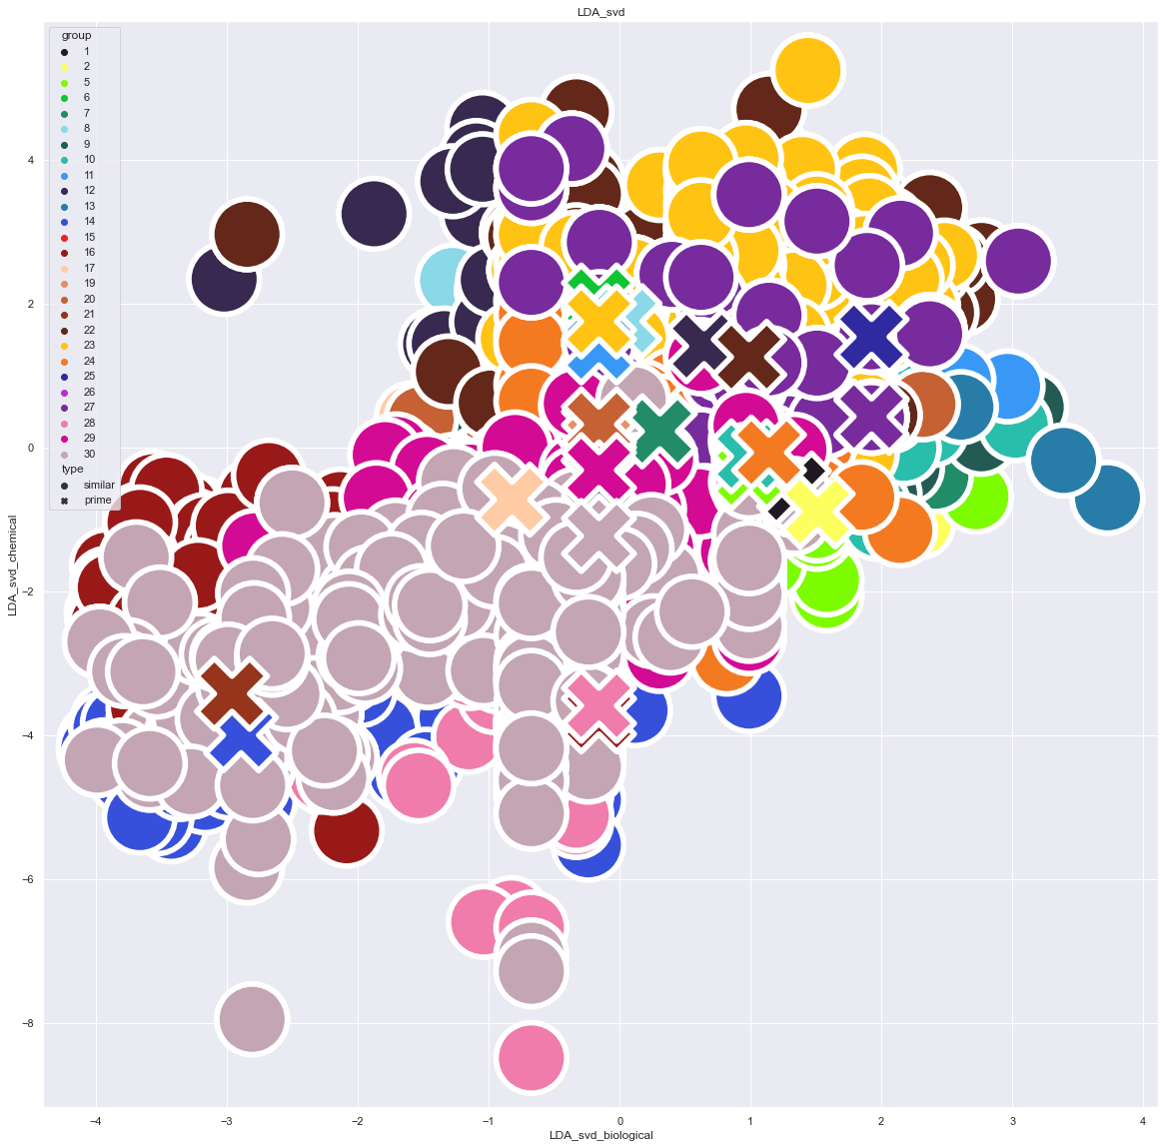
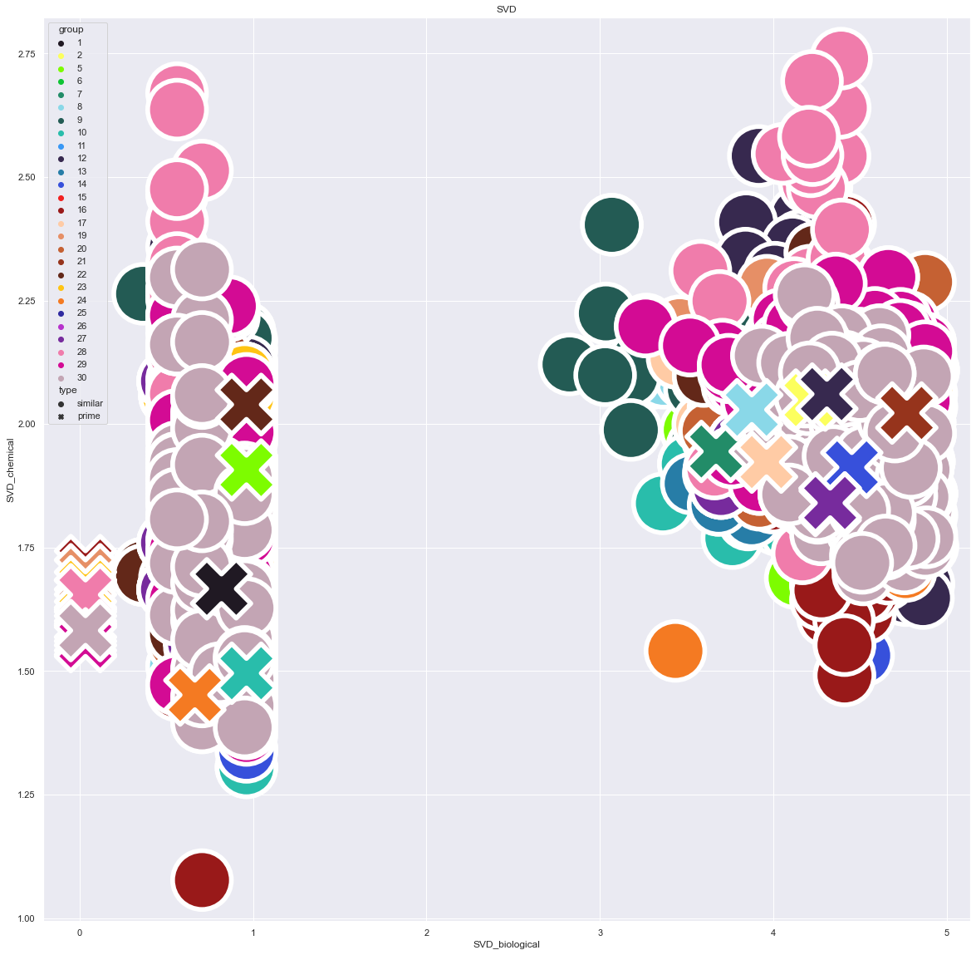
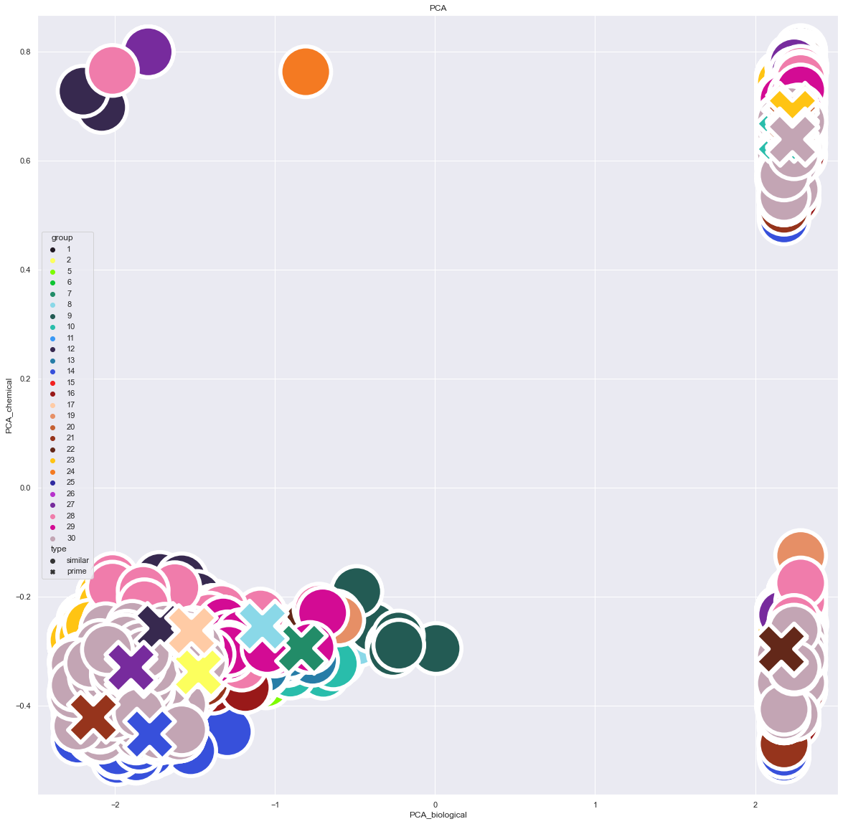
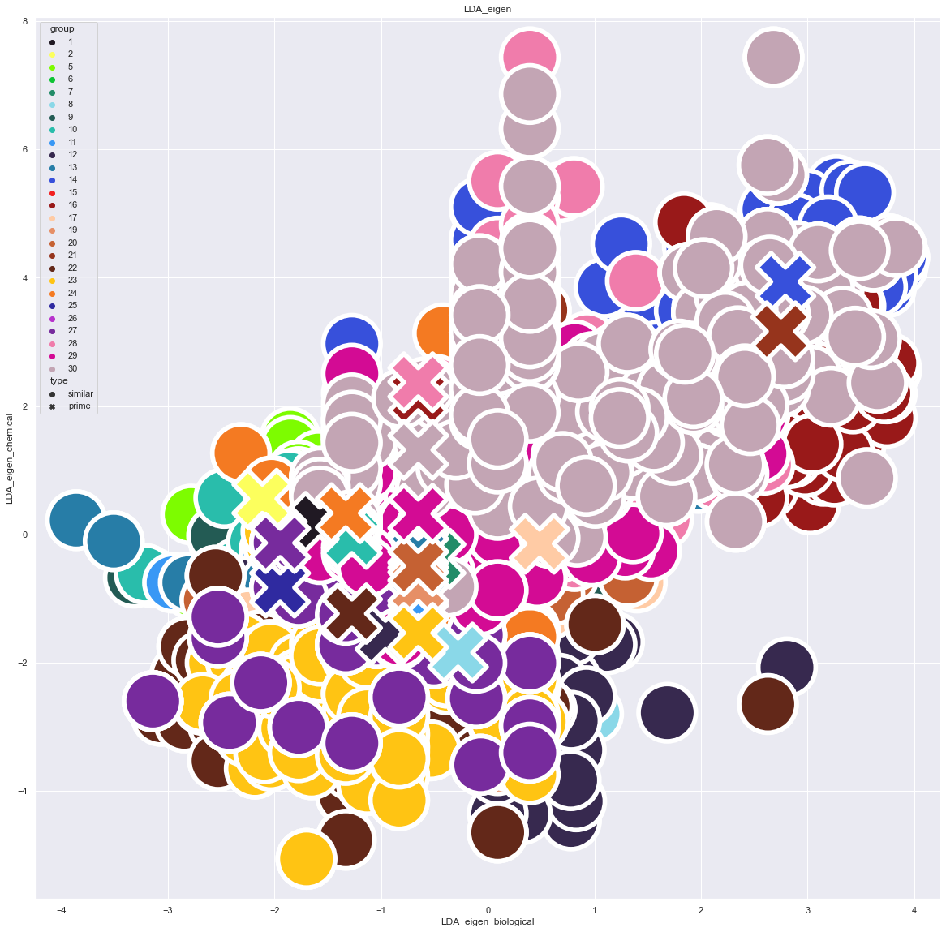
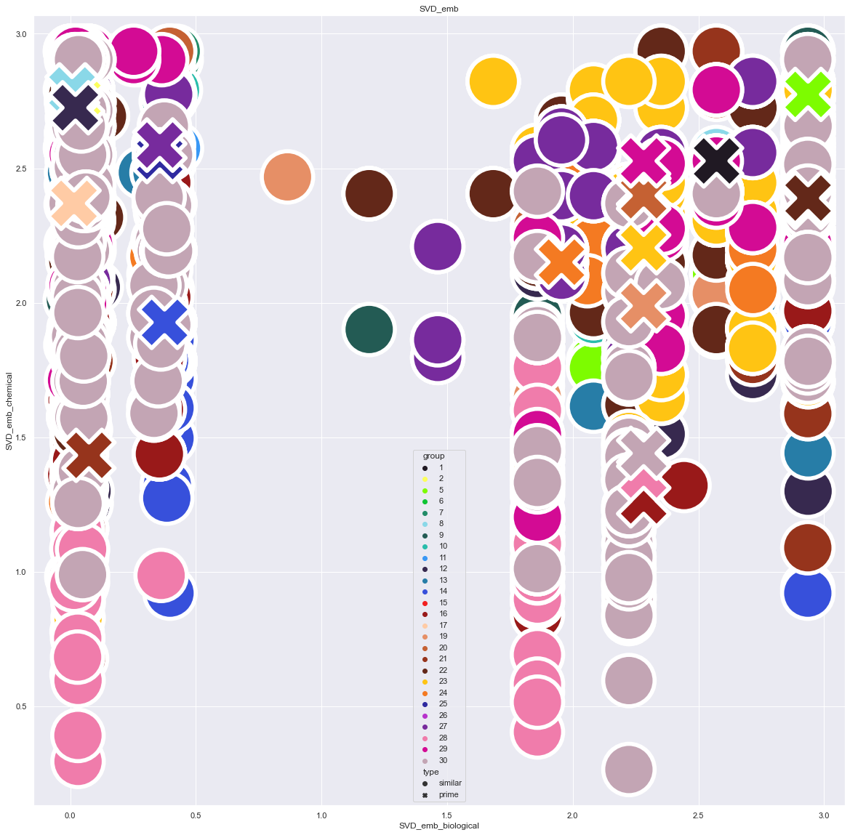
Assessment of biochemical similarity
Data: 3250 molecules
Methods of reducing the space from Sklearn:
2) Linear Discriminant Analysis + SVD
4) TruncatedSVD
1) PCA
3) Linear Discriminant Analysis + eigen
5) tSVD + Random Forest Embedding
Visualization of clustering by methods

Slide 12
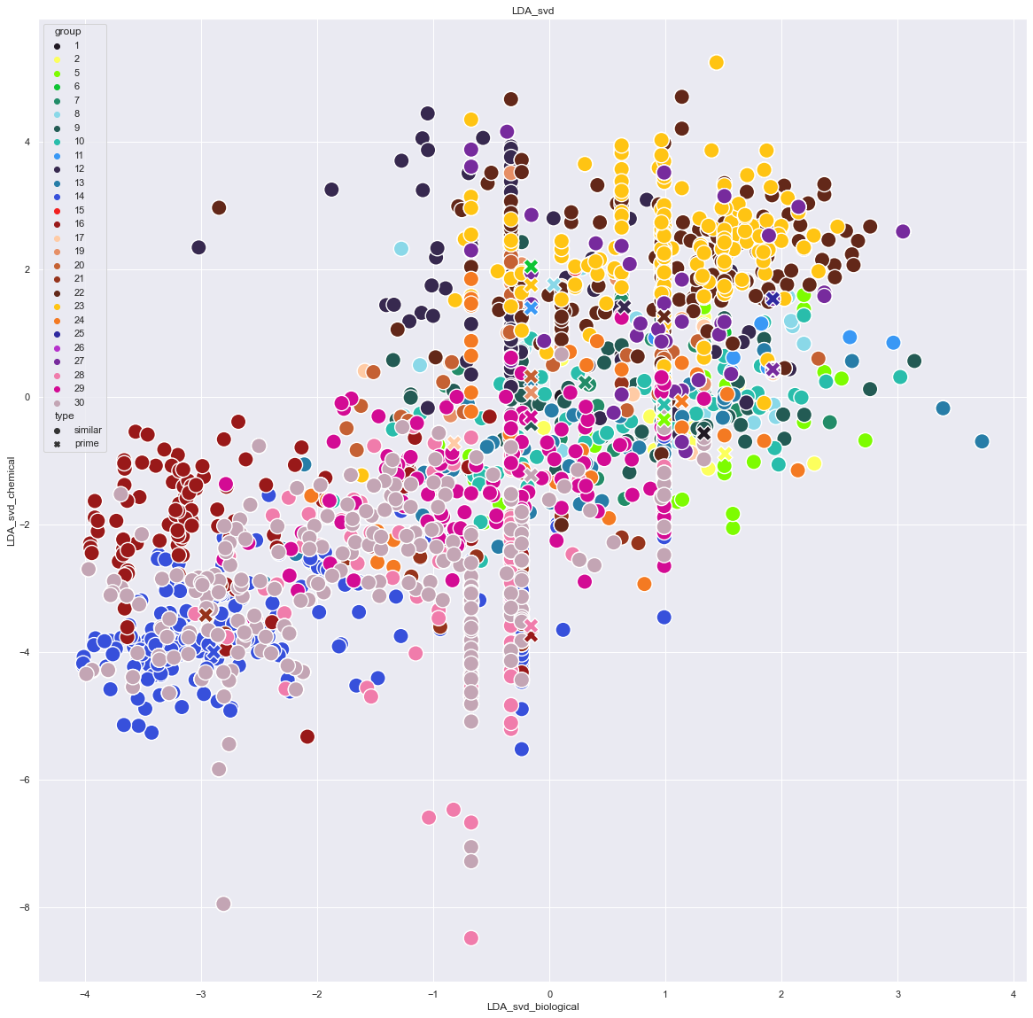
Assessment of biochemical similarity
Assessment of the compactness of clustering :
visually
average deviation
Best methods:
LDA_svd: 0.07
SVD_emb: 0.2
Result: adding 3,250 biochemical similarity assessment molecules to the dataset
Clustering visualization method LDA_svd

Slide 13
Assessment of biochemical similarity
L-Arginine
The compactness of the L-Arginine group in clustering with LDA_svd

Slide 14
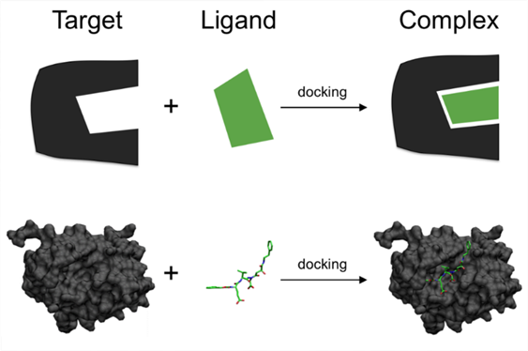
Molecular docking
Structure files: AlphaFold pdb PubChem 3Dsdf
Finding a Linking Site: AutoGrid AutoDock Vina
Docking all 3,250 molecules : Smina
Result: communication energy is added to the dataset
Docking mechanism wikiwand.com/ru/Молекулярный_докинг

Slide 15
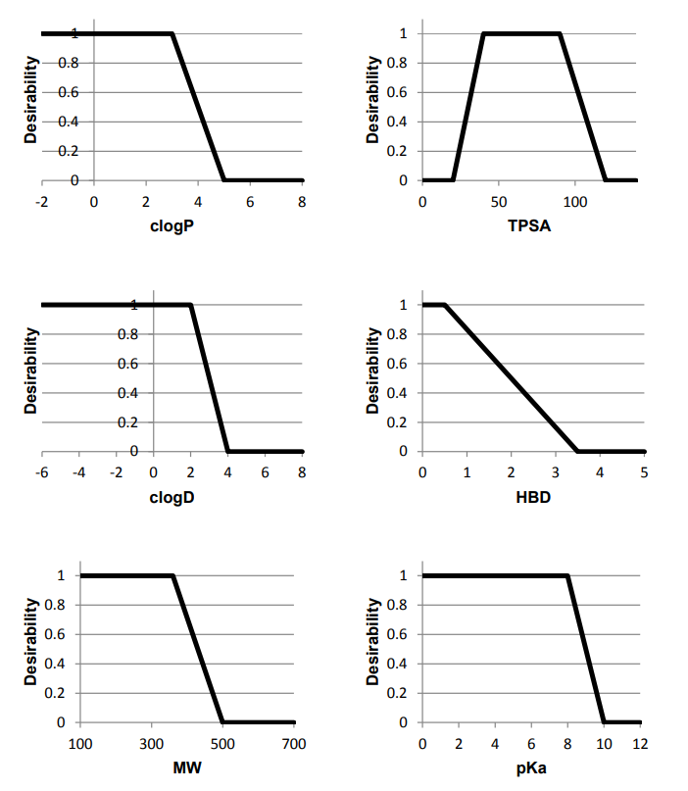
Scoring: mechanism
"Molecular weight" dataset column Molecules with values: 30, 40, 340
Apply a linear preference function:
30 = 0
40 = 0,03
340 = 1
Importance 8
Final score:
0
0,03
1
Examples of preference functions, doi.org/10.2174/138161212799436430
Notes:
О правиле Скоринг используют, когда датасет компаундов большой, с большим количеством свойств, 1 в которых не уверены 100% 2 которые только в совокупности дают правдивый анализ

Slide 16

Scoring: application
Final dataset of 3,250 molecules with the following columns and their importance in scoring:
10: maximum clinical trial phase 4 (step)
8: compliance with Lipinski's rule (step)
6: docking, average free energy of the system (log)
6: docking, average superiority (linear)
6-4: structural similarity (triangular)
6-4: biochemical similarity (linear)
2: number of gene records (linear)
2: number of protein records (linear)
Notes:
О правиле Скоринг используют, когда датасет компаундов большой, с большим количеством свойств, 1 в которых не уверены 100% 2 которые только в совокупности дают правдивый анализ

Slide 17
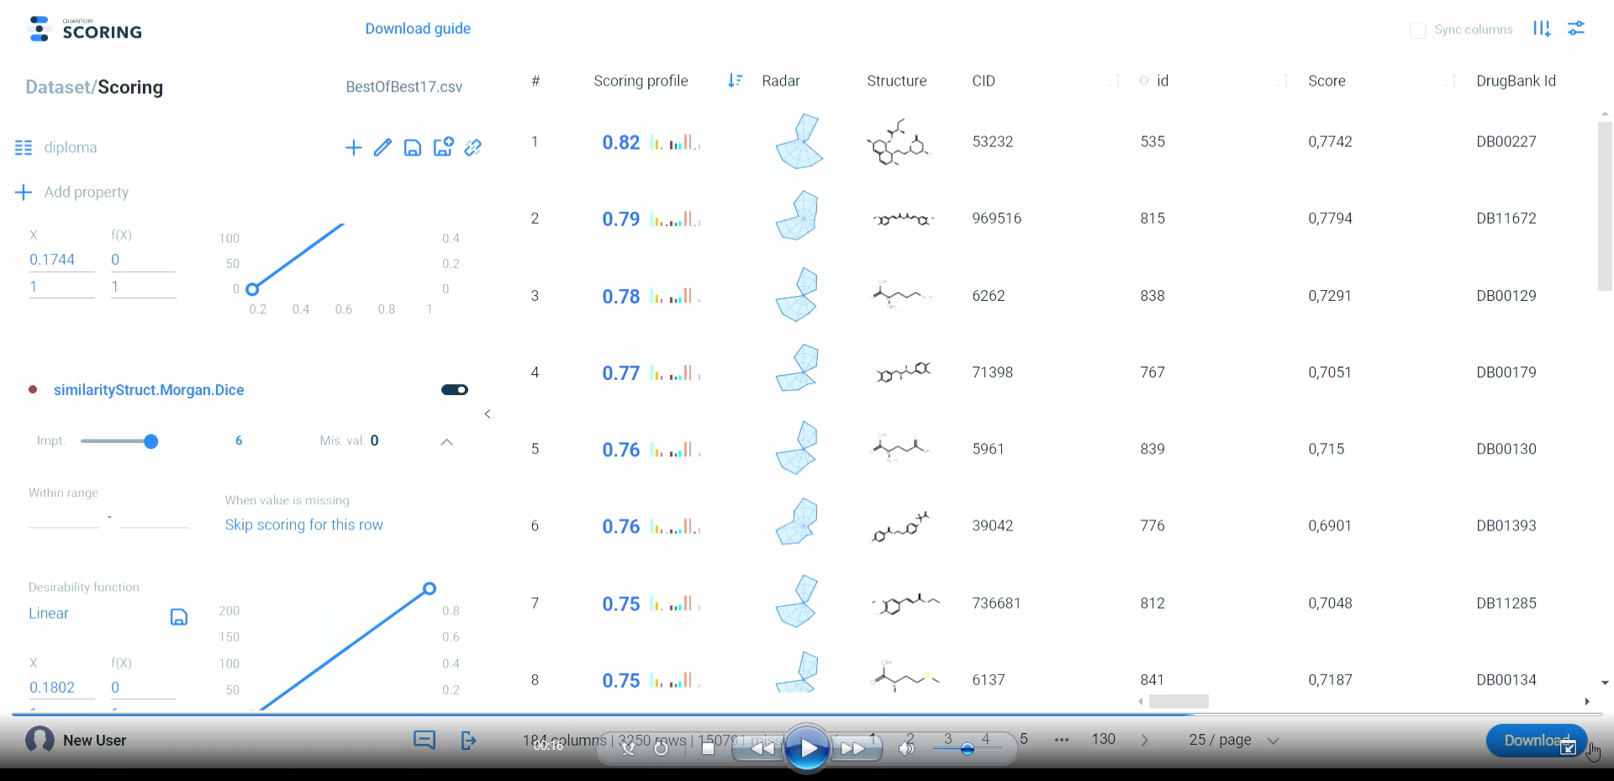
Service demonstration
Итоговый датасет 3250 молекул со следующими колонками и их важность в скоринге:
10: максимальная фаза клинических испытаний 4 (ступенчатая)
8: соответствие правилу Липински (ступенчатая)
6: докинг, ср. св.энергия системы (log)
6: докинг, среднее превосходство (линейная)
6-4: структурное подобие (треугольная)
6-4: биохимическое подобие (линейная)
2: количество записей о генах (линейная)
2: количество записей о белках (линейная)
Notes:
О правиле Скоринг используют, когда датасет компаундов большой, с большим количеством свойств, 1 в которых не уверены 100% 2 которые только в совокупности дают правдивый анализ

Slide 18
Results: additional candidates
By effect on genes:
By protein inhibition:
DrugBank Id | Name | Anna’s genes | All genes | Stage
DB00091 | Cyclosporine | DCXR, HMOX1, LHPP, PC, PLA2G4A, SLC27A3, TMEM192 | 52 | Approved
DB00313 | Valproic acid | DPY19L1, FBN1, GTPBP1, SLC27A3 | 46 | Approved
DB02546 | Vorinostat | ARSB, FBN1, PC, SLC27A3 | 16 | Approved
DB11132 | Silicon dioxide | LHPP, PLA2G4A, SUN2 | 42 | Approved
DB00755 | Tretinoin | FBN1, HMOX1, PC | 37 | Approved
DB00316 | Acetaminophen | ARSB, HMOX1, SLC27A3 | 34 | Approved
DB03843 | Formaldehyde | ARSB, DCXR, DPY19L1 | 20 | Approved
DrugBank Id | Name | All proteins | Stage
DB12010 | Fostamatinib | 25 | Approved
DB00945 | Acetylsalicylic acid | 16 | Approved
DB01017 | Minocycline | 10 | Approved
DB00273 | Topiramate | 8 | Approved
DB00131 | Adenosine phosphate | 8 | Approved

Slide 19
Results: top candidates
Score | Name | CID | DrugBank Id | Like | Source | Suppresses genes | Suppresses proteins | Similarity: structural | Similarity: biochem | Docking
0,8207 | Lovastatin | 53232 | DB00227 | Simvastatin | doi.org/10.1016/j.jtcvs.2019.10.081 |  | TLR4,HMG-CoA Reductase (HMGCR) | 0.9240 | 0.9979 | 1,0
0,7900 | Curcumin | 969516 | DB11672 | Caffeic Acid Phenethyl Ester | doi.org/10.3389/fphar.2020.00826 | PTGS2,RELA,AKT1,AKT2,IL1B,GSTP1,CTNNB1,NOTCH1,FN1,IGF1,IGF2,IL18,TNFRSF10B,STAT3,TNF,IL6,PPARG,VDR,ABCC5,CBR1,GSTP1 | Nuclear factor NF-kappa-B p100 subunit,Nuclear factor NF-kappa-B p105 subunit,Transcription factor p65 | 0.6140 | 0.8985 | 1,0
0,7759 | Ornithine | 6262 | DB00129 | l-Arginine | doi.org/10.1016/j.atherosclerosis.2020.02.024 | OAT,OTC,ARG1,OAZ1,SLC7A1,SLC7A2,SLC25A2,ARG2,SLC25A15,GATM | Fibrillin-1,ADAMTS Like 4 / ADAMTSL4 ,Basigin (BSG),Xanthine Oxidase,Nitric oxide synthase,brain,Nitric oxide synthase,inducible,Nitric oxide synthase,endothelial | 0.7245 | 0.9833 | 1,0
0,7673 | Masoprocol | 71398 | DB00179 | Caffeic Acid Phenethyl Ester | doi.org/10.3389/fphar.2020.00826 |  | Nuclear factor NF-kappa-B p100 subunit,Nuclear factor NF-kappa-B p105 subunit,Transcription factor p65 | 0.5455 | 0.8340 | 1,0
0,7579 | L-Glutamine | 5961 | DB00130 | l-Arginine | doi.org/10.1016/j.atherosclerosis.2020.02.024 | CTPS1,PPAT,GLUL | Fibrillin-1,ADAMTS Like 4 / ADAMTSL4 ,Basigin (BSG),Xanthine Oxidase,Nitric oxide synthase,brain,Nitric oxide synthase,inducible,Nitric oxide synthase,endothelial | 0.6250 | 0.9708 | 1,0
0,7567 | Bezafibrate | 39042 | DB01393 | Caffeic Acid Phenethyl Ester | doi.org/10.3389/fphar.2020.00826 | PPARG,APOA1,APOB,CRP,IGF1,SPP1 | Nuclear factor NF-kappa-B p100 subunit,Nuclear factor NF-kappa-B p105 subunit,Transcription factor p65 | 0.4732 | 0.8179 | 1,0
0,7498 | Azlocillin | 6479523 | DB01061 | LY3039478 (Crenigacestat) | Anna’s unpublished article | pbpA | Presenilin-1,nicastrin,APH-1A (Gamma-secretase subunit APH-1A),APH-1B (Gamma-secretase subunit),PEN-2 (presenilin enhancer 2),Basigin (BSG) | 0.5246 | 0.8219 | 0,7

Slide 20
Results: one of the best
Caffeic Acid Phenethyl Ester, CID108042
Suppresses osteogenic differentiation: doi.org/10.3389/fphar.2020.00826
Inhibits the Nuclear factor NF-kappa-B complex, which consists of:
Nuclear factor NF-kappa-B p100 subunit
Nuclear factor NF-kappa-B p105 subunit
Transcription factor p65
In pathway: AKT/NF-κB/NLRP3 Inflammasome
Clinical trials: none
3D structure CAPE, PubChem
Notes:
фазы нет – найдём схожий одобренный, будет супер

Slide 21
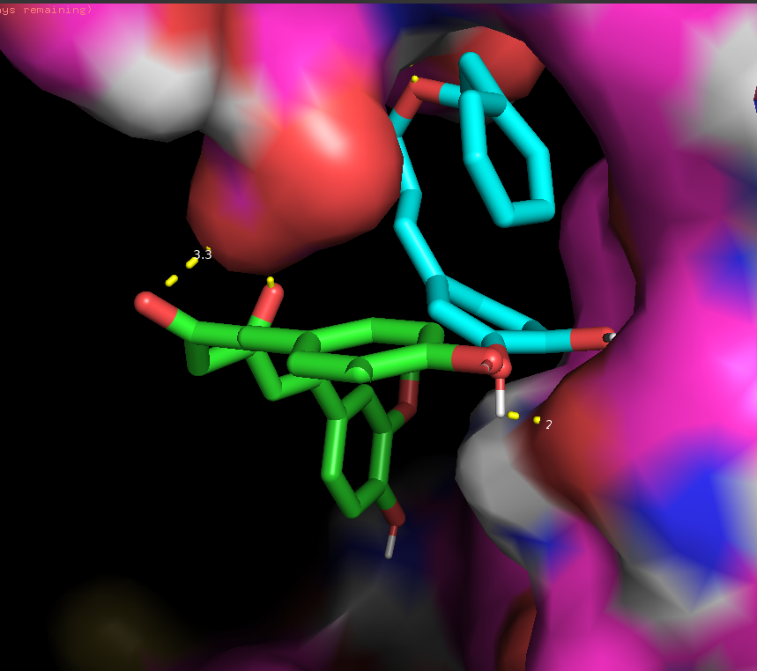
Results: one of the best
Curcumin
Similar to caffeic acid phenethyl ester, which inhibits osteogenic differentiation: doi.org/10.3389/fphar.2020.00826
Place: 2, score: 0.79 Structural similarity: 0.61 Biochemical similarities: 0.89 Average free energy of the system : -9.56 kcal/mol Docking score: 1.0
Binds as well as or better to all proteins in the Nuclear factor NF-kappa-B complex -> potentially suppresses osteogenic differentiation and disease development
Already used for: chronic schizophrenia, type 2 diabetes, periodontitis, etc.
Docking Nuclear factor NF-kappa-B p105 subunit,
CAPE -9 vs Curcumin -9.5 kcal/mol
Notes:
Подводные камни

Slide 22

Conclusions
After validation by biologists, the top 20 candidates can be tested in the lab.
The approach of using combined data and their final scoring is efficient.
The developed Scoring service works without errors and provides complete and convenient functionality for drug development.
For greater accuracy it is worth: on the best candidates do more resource docking (moving + parameters), with additional targeting/multitargeting, and using real structures (not AlphaFold).
Structural similarity: the Dice and Taminoto metrics do not give different results on a 10% dataset sample, but Dice is supported by more methods. For fingerprinting, it is better to use all possible methods and combine results.
Biochemical similarity: PCA method for clustering does not work representatively, better to use LDA_SVD, TruncatedSVD or a combination of them.
Docking: Virtual screening by docking gives controversial results - use with other methods.
Searching for drugs by genes and targeting gives good results - worth expanding datasets with other databases and performing detailed analysis.
Notes:
Может быть использован и для исследования других заболеваний. С

Slide 23
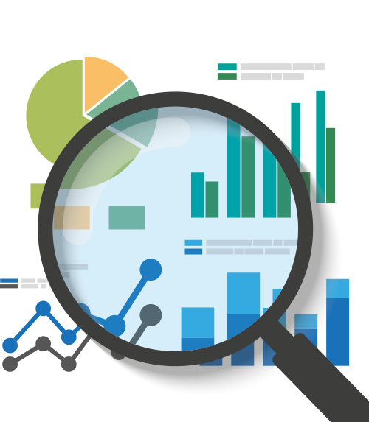
Thank you for your attention
Code in the repository
Datasets on Google Sheets
pustoshilov.dv@phystech.edu
tg: @pustoshilov_d
+7 (910) 59-071-83

Slide 24
Optional: docking
Data: AlphaFold pdb, PubChem 3Dsdf
Conversion: OpenBabel
Finding a Linking Site: AutoDock Vina AutoGrid AutoDock forcefield exhaustiveness 8
Docking: Cluster of Quantori DockingFactory: Smina minimalization, бокс +4Å exhaustiveness 5
Docking mechanism wikiwand.com/ru/Молекулярный_докинг

